Slide 1
Topic 8: Capacitance
8.1 Capacitors and Capacitance
8.2 Energy stored in a capacitor

Slide 2




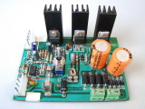
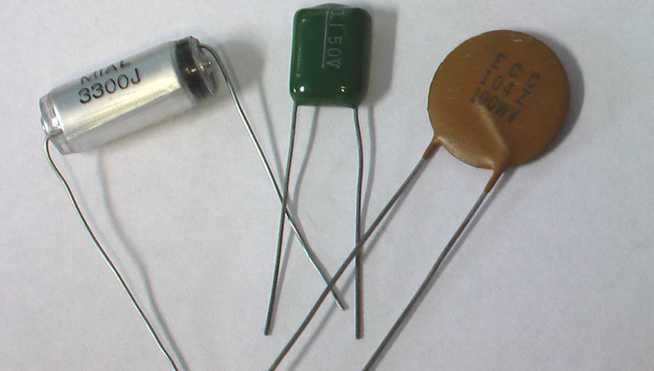
Capacitors in Circuits
Capacitors
Capacitors

Slide 3
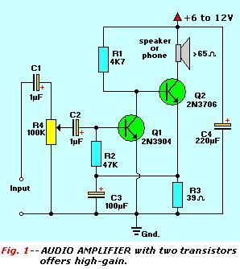

Capacitors in Circuit-Diagram
Symbol
Capacitors

Slide 4
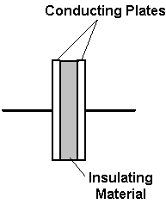

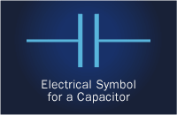
What is a Capacitor
A capacitor is a device that can store charge/energy
It consists of two plates (conductors) separated by an insulator

Slide 5
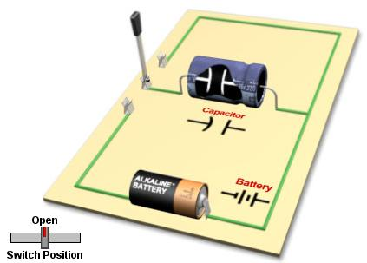
How a Capacitor Works
CLICK

Slide 6
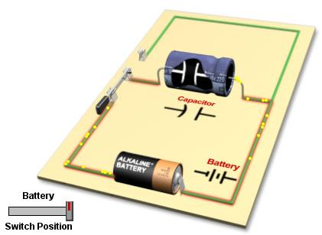
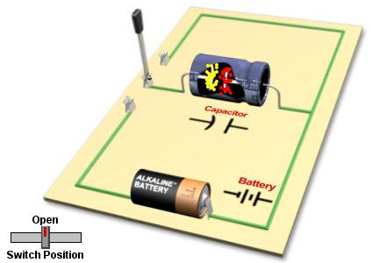
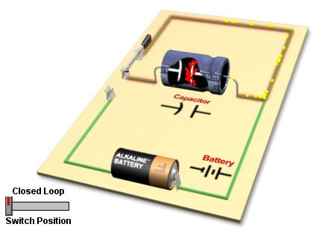
How a Capacitor Works
Electrons flow from one plate of the capacitor to the other. The capacitor loses its charge and V.
Discharging
Charging
Electrons move from the negative terminal of the cell to one plate of the capacitor and from the other plate to the positive terminal of the cell.
Fully-Charged
V_{capacitor} = e.m.f of cell
No current flow in the circuit.

Slide 7
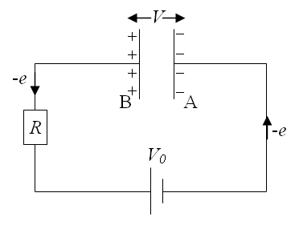
Principle of Charging & Discharging
When the capacitor is charging, electrons flow from the battery's negative terminal to plate A and then from the other plate B to the positive terminal.
Equal amount of positive and negative charge then accumulate at B and A respectively which will result in the existence of a p.d., V, across the plates. This p.d. is counteractive to the e.m.f of the battery.
When V reaches V₀ (maximum value), no current flows through the circuit. There is now an accumulation of Q amount of charge in the capacitor on either plate.
During the discharging process where the battery is disconnected, the reverse flow of the electrons occur.

Slide 8
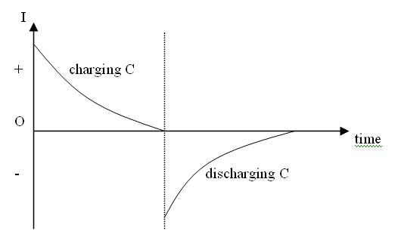
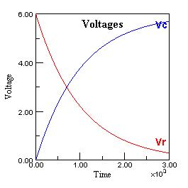
Charging & Discharging
Current-Time Graph
Voltage-Time Graph
V_{c} = Charging
V_{r} = Discharging

Slide 9
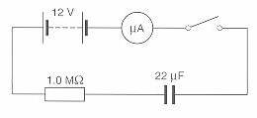
Example 1
The diagram shows a capacitor connected in series with a resistor, a low resistance micro-ammeter, a switch and a 12 V battery.
(a) When the switch is first closed, what is
(i) the p.d. across the capacitor
(ii) the p.d. across the resistor
(iii) the current
(iv) the charge on each of the capacitor plates?
(b) Calculate the same quantities as in (a) when the switch has been closed for some time so that steady conditions have been reached.
Solution:
(a) (i) 0 (ii) 12 V
(iii) I = V / R = 12 / 1.0 ×10⁶ = 12 μA (iv) 0
(b) (i) 12 V (ii) 0
(iii) 0 (iv) Q = CV = 22 ×10⁻⁶ ×12 = 264 μC

Slide 10
Uses of Capacitors
Capacitors are used in several different ways in electronic circuits:
Store charge for high-speed use such as a camera flash.
Smoothen out DC voltage that has ripples.
Block DC voltage, no current will flow between the poles of the battery once the capacitor is charged.

Slide 11
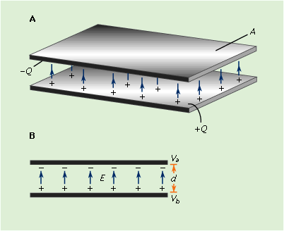
Accumulation of Charge
The quantity of charge Q accumulated on the plates is directly proportional to the potential difference V across the plates.
Q ∝ V
Therefore Q / V = constant
We call this constant, capacitance.

Slide 12
Capacitance
Capacitance is a measure of the charge storing ability of a capacitor.
Capacitance C, is defined as the ratio of the charge Q stored on either plate to the potential difference V between the plates.
Thus:
C = Q / V
The unit of C is farad (F). 1 farad is 1 coulomb per volt.
The values of C are usually in the range of micro-farads (μF, 10⁻⁶ F) to pico-farads (pF, 10⁻¹² F).

Slide 13
Example 2
A capacitor of capacitance 10 μF is connected to a battery of e.m.f. 12 V. What is the charge on its plates?
What potential difference must be applied between the plates of a 100 μF capacitor for the charge on them to be +0.025 C and -0.025 C?
Solution:
C = Q / V
(a) Q = CV = (10 × 10⁻⁶) × 12 = ±1.2 × 10⁻⁴ C
(b) V = Q / C = 0.025 / (100 × 10⁻⁶) = 250 V

Slide 14
Example 3
Complete the following table which gives the charge q on a capacitor of capacitance C when there is a p.d. V across it. Express your answers using prefixes (not the standard form)
V | 12.0 V |  | 1.5 V |  | 100 V | 600 mV
C | 2.2 μF | 5000 μF | 4.7 μF | 220 μF
q |  | 10 mC |  | 66 μC | 1.0 nC | 280 μC
2,0 V
0.3 V
10 pF
470 μF
26 μC
7.1 μC

Slide 15
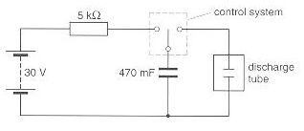
Example 4
A large capacitor is used as shown above, in a camera flash unit. Calculate
The charge it stores when the control system connects the capacitor directly to the 30 V power supply
The average discharge current if any, when the control system connects the capacitor to the discharge tube, it discharges in 0.20 ms
Solution:
(a) Q = CV = (470 × 10⁻³) × 30 = 14 C
(b) I = Q / t = 14 / (0.20 × 10⁻³) = 70 kA

Slide 16
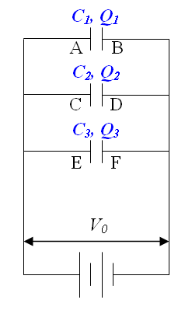
Capacitors in Parallel
For capacitors charged in parallel, it can be proved that the effective capacitance C of such connections is given by:
C = C₁ + C₂ + C₃ + ... + C_{n}
For three capacitors connected in parallel,
V_{AB} = V_{CD} = V_{EF} = V₀
upon complete charging.
By conservation of charge, total charge Q for the three capacitors is:
Q = Q₁ + Q₂ + Q₃
= C₁V₀ + C₂V₀ + C₃V₀
If the effective capacitance is C, then
Q = CV₀ = C₁V₀ + C₂V₀ + C₃V₀ giving
C = C₁ + C₂ + C₃
Q = CV

Slide 17
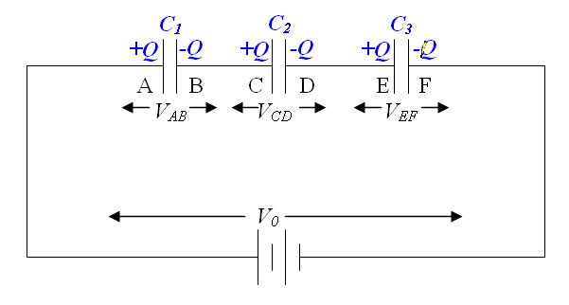
Capacitors in Series
When charged in series, it can be proved that the effective/combined capacitance C for series connections of capacitors is:
1/C = 1/C₁ + 1/C₂ + 1/C₃ + ...+ 1/C_{n}
Proof
V₀ = V_{AB} + V_{CD} + V_{EF}
V₀ = Q/C₁ + Q/C₂ + Q/C₃
Q/C = Q/C₁ + Q/C₂ + Q/C₃
∴ 1/C = 1/C₁ + 1/C₂ + 1/C₃
V = Q / C

Slide 18
Example 5
A steady p.d of 200 V is maintained across a combination of two capacitors, A of capacitance 2.0 μF and B of capacitance 0.50 μF in series. What is
(a) the combined capacitance
(b) the charge stored in each capacitor
(c) the potential difference across each capacitor?
Solution:
(a) 1/C = 1/C₁ + 1/C₂
C = C₁C₂ / (C₁ + C₂)
= (2.0 × 10⁻⁶ × 0.50 × 10⁻⁶ ) / [(2.0 + 0.50) × 10⁻⁶]
= 0.40 μF
(b) Q = CV = 0.4 × 10⁻⁶ × 200 = 80 μC
(c) V₁ = Q / C₁ = 80 × 10⁻⁶ / 2.0 × 10⁻⁶ = 40 V
V₂ = Q / C₂ = 80 × 10⁻⁶ / 0.50 × 10⁻⁶ = 160 V

Slide 19
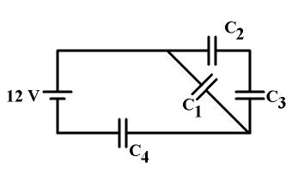
Example 6
The four capacitors have the following values:
C₁ = C₂ = 90 pF.
C₃ = 45 pF
C₄ = 120 pF
What is the potential difference across each capacitor? How much charge is on each capacitor?

Slide 20
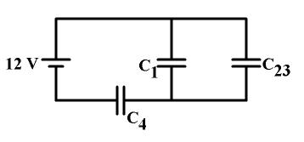
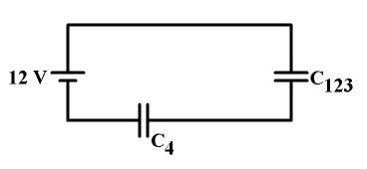
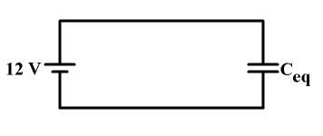
Solution 6 (1)
1
2
3

Slide 21
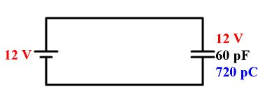
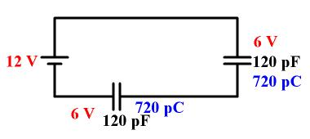
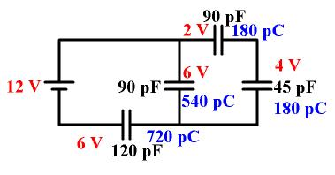
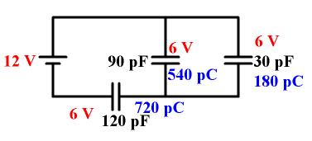
Solution 6 (2)
1
2
3

Slide 22
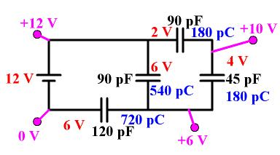
Solution 6 (3)
Potential drops from +12 V to 0 V

Slide 23
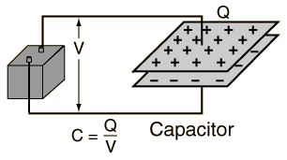
Energy Stored in a Capacitor
A charged capacitor stores electrical energy which is equivalent to the work done W for depositing Q charge on its plates.
W = QV (From definition, V = W / Q)
However, p.d. across the capacitor increases from zero to V as charges are being deposited. Hence the effective or average p.d. is ½V.
Therefore, W = Q (1/2 V) = 1/2 QV
W = 1/2 QV = 1/2 CV² = 1/2 Q² / C
If C is in farads, Q in coulombs and V in volts, then W has a unit of joule.

Slide 24
Example 7
Find the charge and the energy stored by a 1000 μF capacitor when the potential difference across it is (a) 6.0 V (b) 12.0 V
Solution:
(a) Q = CV = 1000 × 10⁻⁶ × 6.0 = 6.0 mC
E = ½ CV² = ½ × 1000 × 10⁻⁶ × 6.0² = 18 mJ
(b) Q = CV = 1000 × 10⁻⁶ × 12 = 12.0 mC
E = ½ CV² = ½ × 1000 × 10⁻⁶ × 6² = 72 mJ

Slide 25
Example 8
A 47 μF capacitor in a flash-gun supplies an average power of 1.0 × 10⁴ W for 2.0 × 10⁻⁵ s. What is the potential difference across the capacitor before it is discharged?
Solution:
E = ½ CV²
Pt = ½ CV²
Therefore, V = √(2Pt / C)
V = √[(2 × 1.0 × 10⁴ × 2.0 × 10⁻⁵) / ( 47 × 10⁻⁶)]
= 92.3 V

Slide 26
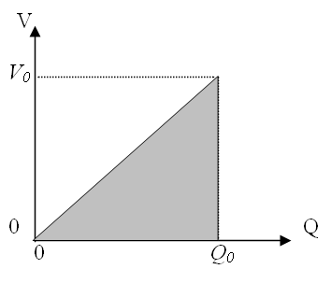
Energy Stored is Represented by Area under a V-Q Graph
When V is plotted against Q for a charging capacitor, a straight line is obtained (as V = Q / C), the area under the graph represents energy stored in the capacitor.
Proof:
Work done in depositing a small charge dQ at potential difference of V is V dQ
Energy Stored = Total Work Done W
= ∫ dW =∫ V.dQ =∫ (Q/C).dQ
= area under the curve.
Therefore, for charging a capacitor from Q = 0 to Q = Q₀ :
W = ½ Q₀² / C (from integration)
OR
E = area under the V-Q graph = ½ Q₀ V₀
V
dQ

Slide 27
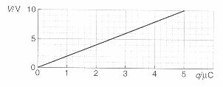

Example 9
The graph shows how the potential difference across a capacitor changes as it is charged.
(a) What is the capacitance of the capacitor?
(b) (i) Calculate the energy stored in the capacitor when it has a charge of 1, 2, 3, 4, 5 μC.
(ii) Sketch a graph of energy stored against charge.
(iii) What shape would a graph of energy against p.d. have?
Solution:
(a) C = Q / V = 5 × 10⁻⁶ / 10 = 0.5 μF
(b) E = ½ QV OR E = Area under graph
E
E
Q / μF | 1 | 2 | 3 | 4 | 5
V / V | 2 | 4 | 6 | 8 | 10
E / J | 1 | 4 | 9 | 16 | 25
Q
V

Slide 28
Energy Loss in Charging a Capacitor
If the total charge supplied by the battery is Q₀ and the p.d./e.m.f. of the battery is V₀, then the total energy output by the battery is Q₀V₀.
But the energy stored or received by the capacitor is only 1/2 Q₀V₀ hence energy is lost as heat H in the connecting wires.
H = Q₀V₀ − 1/2 Q₀V₀ = 1/2 Q₀V₀

Slide 29
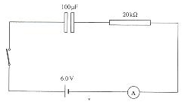
Example 10
(a) In the circuit shown, the switch is closed and sometime later the ammeter reads 210 μA. Calculate for that instant
(i) the p.d. across the resistor,
(ii) the p.d. across the capacitor.
(b) When the capacitor has become fully charged, calculate
(i) the energy stored in the capacitor,
(ii) the total energy taken from the battery.
Solution:
(a) (i) V = IR = 210 × 10⁻⁶ × 20 × 10³ = 4.2 V
(ii) V across capacitor = 6.0 – 4.2 = 1.8 V
(b) (i) E_{capacitor} = ½ CV² = ½ × 100 × 10⁻⁶ × 6.0² = 1.8 × 10⁻³ J
(ii) E_{battery} = 2 (E_{capacitor}) = 2 (1.8 × 10⁻³)= 3.6 × 10⁻³ J

Slide 30
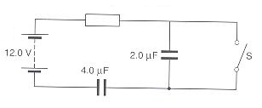
Example 11
In the circuit shown,
Calculate the energy stored
In the 4.0 μF capacitor
(a) with the switch S closed
(b) with the switch S open
Solution:
(a) When S is closed, only the 4.0 μF capacitor is charged.
Therefore, energy stored = ½ CV² = ½ × 4.0 × 10⁻⁶ × 12² = 288 μJ
(b) When S is open 1/C = 1 / 4.0 + 1 / 2.0,
C = 4/3 μF
Q = CV = 4/3 ×12 = 16 μC
E = ½ × Q² / C = ½ × 16² / 4.0 = 32 μJ

Slide 31
The End

